Slide 1
Process Management
Alok Jhaldiyal
Assistant Professor
SoCSE, UPES
Dehradun

Slide 2
What a process is ?
Process is
A program in execution
Unit of work of most operating systems
Requires resources – CPU time, memory, I/O devices
A system may consist of multiple running processes: System process running system code and user process running user code.
Traditionally process used to have a single thread but modern operating system contains multiple thread.
Important aspects of process management: Thread management, creation and deletion of process, scheduling process and maintain a synchronized and a communicated state.

Slide 3
The Process
A program is set of instruction stored in computers memory.
A program may be active or in a passive state.
Program in active state is a process.
Process includes a program counter and data stored in the processor registers.
A process generally includes process stack which contains temporary data, a data section, and also a heap.

Slide 4
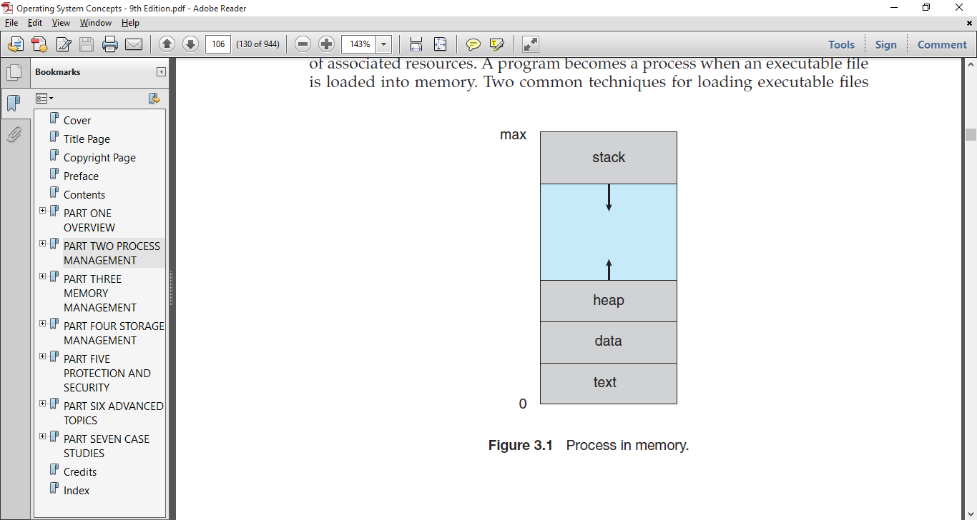
Process Stack contains temporary data such as function parameters, return addresses, and local variables.
Data section contains global variables
Heap is the dynamically allocated memory during runtime.
And text is program instructions
Process in Memory

Slide 5
More about process
A program becomes a process when an executable file is loaded into memory.
Two processes may be associated with the same program, they are nevertheless considered two separate processes.
Example can be a browser in which user has opened multiple tabs, but active tab is a separate process.

Slide 6
Process State
When a process executes, it is in some state that we call process state.
A process may be in one of the following states:
New. The process is being created.
Running. Instructions are being executed.
Waiting. The process is waiting for some event to occur (such as an I/O completion or reception of a signal).
Ready. The process is waiting to be assigned to a processor.
Terminated. The process has finished execution

Slide 7
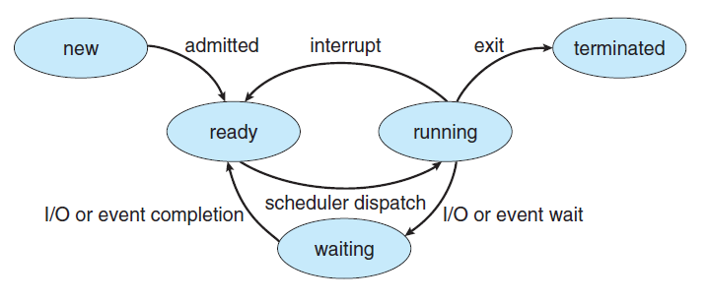
Process State Diagram

Slide 8
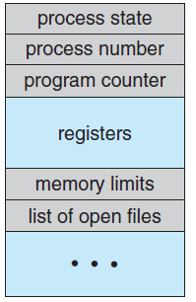
Process Control Block
Representation of a process in operating system is done using a Process Control Block (PCB) or Task Control Block.
A PCB is tiered block and each block holding information associated with the particular process.
Process Control Block

Slide 9
Process Control Block
Pieces of information in PCB:
Process state: New, Ready, Running, Waiting, Halted and Terminated.
Program counter: Indicates the address of the next instruction.
CPU registers:
Vary in type and number
Includes accumulators, index registers, stack pointers, and general-purpose registers
During interrupt process state and program counter information is stored in registers.
CPU-scheduling information: Includes a process priority, pointers to scheduling queues, and other scheduling parameters.

Slide 10
Memory-management information: Might include value of the base and limit registers and the page tables, based on the memory system used by the underlying system.
Accounting information: This information includes the amount of CPU and real time used, time limits, account numbers, job or process numbers.
I/O status information: Includes the list of I/O devices allocated to the process and list of open files.

Slide 11
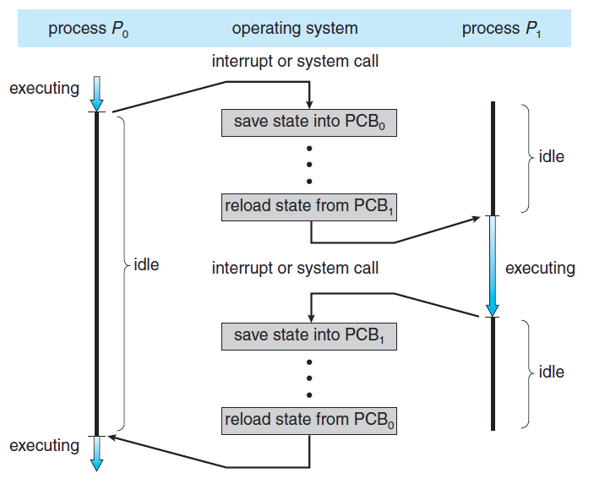
CPU Switching between two concurrent processes

Slide 12
Include this in your Assignment 1
Class Activity: Assume that a process [P1] is running in which user is recording his voice and at the same time process [P2] getting the voice converted into text form i.e. Based on the above scenario:
List all the required resources in context to operating system to run this process successfully.
Assume that during execution of process P1 suffers from one interrupts after 20ns of execution and P2 face interrupt second after 60ns, using a diagram show the CPU switching. Consider CPU requirement for P1 is 80 and P2 is 100 and to handle interrupt 1 it takes 5ns and interrupt 2 10ns.
Consider process P1 is picked by the scheduler at the inception of this scenario.

Slide 13
Context Switching
Context Switch: A context switch is the mechanism to store and restore the state or context of a CPU in Process Control block (PCB) so that a process execution can be resumed from the same point at a later time.
Process to switch the CPU between multiple programs which want to run on the system is context switching.
Act of context switching can only be performed in kernel mode as only in kernel mode page map can be changed.

Slide 14
Context Switching
Get into kernel mode.
Save the old program's registers somewhere, and the address of the next instruction it was about to execute, so they can be restored later, save in its PCB.
Save the mappings in the current page map, also into the PCB.
Unmap all of the old program's pages from the page map.
Choose a new program to re-start. Find its PCB.
Re-map the pages of the new program from its PCB.
Re-load the registers of the new program from its PCB.
Return to the next instruction of the new program, and return to user-mode at the same time.

Slide 15
Process Scheduling
Multiprogramming aims to maximize CPU utilization and it requires CPU to have some process running at all times, to maximize CPU utilization.
Idea is to switch between CPU so frequently that the CPU can interact with each program.
A process scheduler helps CPU find a available process.

Slide 16
Scheduling Queues
All incoming jobs are kept in a job queue.
Processes residing in main memory and are ready to be executed are kept in ready queue.
Ready queue is a linked list and headers contain pointers to the first and last process PCB.
Each PCB has a header field that holds the pointer to the next process PCB.
A process waiting for a shared device is kept in a device queue.
Each device has its own device queue and a oval denotes a resource.

Slide 17
Queuing Diagram
A common representation of process scheduling is a queueing diagram.
A queuing diagram is made of ovals and rectangles and connected using arrows.
Two types of queues are present: the ready queue and a set of device queues.
Rectangular box represents a queue

Slide 18
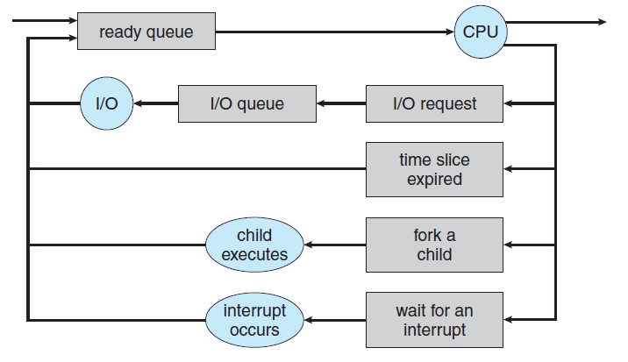
A new process waits in a ready queue.
Once process is assigned a CPU, it is executing.
Once a process is executing several events may occur:
The process could issue an I/O request and then be placed in an I/O queue.
The process could create a new child process and wait for the child’s
termination.
The process could be removed forcibly from the CPU, as a result of an
interrupt, and be put back in the ready queue.

Slide 19
Schedulers
A process since its creation passes through several queues.
A schedulers responsibility is to select an appropriate and available process.
Before getting a CPU time a process is spooled in memory disk.
Schedulers types:
Long term scheduler
Short term scheduler
The two schedulers are distinguished by the frequency of there operation.

Slide 20
Schedulers
Short term scheduler:
It is CPU scheduler
Selects from among the processes that are ready to execute and allocates the CPU to one of them.
A CPU might run for few milliseconds before waiting for a input.
A short term scheduler needs to be very fast to select a process and assign CPU.
It often switches process at every 100 milliseconds.

Slide 21
Schedulers
Long term schedulers:
These schedulers function less frequently, often minutes may separate two process.
Long term schedulers control the degree of multiprogramming in the system i.e. process loaded in the memory.
The rate to process creation must match the process departure rate.
Long term schedulers have flexibility to give more time to select a process.

Slide 22
Schedulers
For efficiently utilizing CPU time a long term scheduler should select a proper mix of processes.
A process is usually Input bound or CPU bound:
Input Bound: It is a process that spends more of its execution time waiting for inputs.
CPU Bound: A CPU bound generates I/O requests infrequently, using more of its time doing computations
If all processes are I/O bound, the ready queue will almost always be empty, short term scheduler will have very less to do.
If all processes are CPU bound, the I/O waiting queue will almost always be empty, devices will go unused

Slide 23
Operations on Process
Most systems run processes dynamically and for this to be implemented, multiple processes needs to be created and destroyed.
Broadly operations on process include:
Process Creation
Process Destruction

Slide 24
Process Creation
During the course of execution a process may create multiple new processes.
Creating process is parent process and new process created is child process.
Operating Systems (UNIX, Linux and Windows) identify process using a unique identifier called PID.
PID is a integer and is used as index to various attributes of a process.

Slide 25
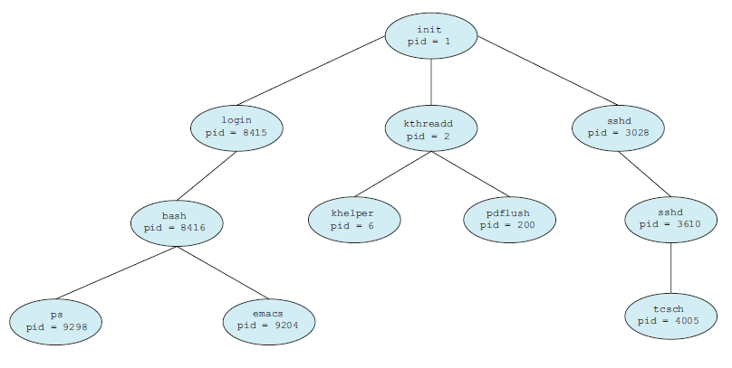
A tree of Processes in a Linux System

Slide 26
Process Creation
When a new process is created there may exist some scenarios:
The child program may request the required resources directly from the OS.
Parent may partition its resources among its children.
Partitioning the resources avoids over burdening the OS
Also two possibilities of execution exist:
The parent continues to execute concurrently with its children.
The parent waits until some or all of its children have terminated.
Two address-space possibilities for the new process:
The child process is a duplicate of the parent process (it has the same program and data as the parent).
The child process has a new program loaded into it.

Slide 27
Process Creation
A new process is created by a fork() system call (UNIX).
New process consists of a copy of the address space of the original process, which allows communication between parent and child.
Both parent and child execute after fork()
Child process has a return identifier 0.
Parent process has a non-negative return identifier
Child process is an identical copy of parent process.
The new processes can start execution using exec() system call.
In PCB every process has a reference to its parent process, hence sharing of resources is possible.
If a parent process has nothing to do and is waiting for child to finish then it can enter to waiting using wait() sys call.

Slide 28
fork() Demonstration
#include <sys/types.h>
#include <stdio.h>
#include <unistd.h>
int main()
{
pid_t pid;
/* fork a child process */
pid = fork();
if (pid < 0) { /* error occurred */
fprintf("Fork Failed");
}
else if (pid == 0) { /* child process */
execlp("/bin/ls","ls");
}
else { /* parent process */
/* parent will wait for the child to complete */
wait();
printf("Child Complete");
}
return 0;
}

Slide 29
Process Termination
Process terminates when it finishes executing.
Terminates using exit() system call.
A terminating process informs its parent by returning a integer.
All the resources i.e. physical and virtual memory, open files, and I/O buffers are deallocated by OS.
A parent can also abruptly terminate a process based on following reasons:
Child has exceeded its usage of some of the resources.
The task assigned to the child is no longer required.
The parent is exiting, and the operating system does not allow a child to continue if its parent terminates

Slide 30
Class Activity
How is degree of multiprogramming maintained?
Draw PCB and explain each building block.
Redraw below figure including the details of scheduler responsible for moving processes between different ovals.
Ready Queue
CPU
Job Queue
I/O Devices

Slide 31
Home Work: Demonstrate process creation in a windows environment.

